Slide 1

Boldly and Brilliantly Build Your Brand
NEWPF
October 12, 2023

Slide 2


Power, Presence, and Personal Brand
Be Aware. Be Thoughtful. Choose.
  Power
  Powerful First Impressions
  Executive Presence
    What people THINK when you are “in the room” or “on the Zoom”
      Emotional and Physical Components including Bold, Muscular Language
  Personal Brand
    What people SAY when you are NOT “in the room” or “on the Zoom”
    Know your brand! Pitch your brand! Punch your brand!

Slide 3


Power is Critical to Success:
We CHOOSE
Seize Power
or
Cede Power

Slide 4

To Seize Power?
No!
Yes!
Aggressive
Authoritarian
Narcissistic
Greedy
Don’t want to make waves
Shouldn’t have to!
Gives us a voice
Enables us to influence
Impact outcomes
Take risks: fail/survive/thrive
Accomplish goals
Succeed!

Slide 5
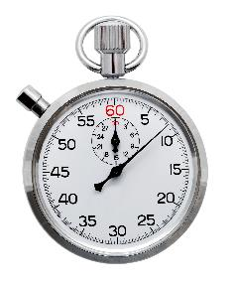

“Powerful Leaders Make
Unforgettable First Impressions”
-- Forbes
In 7 seconds, people assess competency and confidence based on:
Posture
Poise
Style
Before You Speak a Word . . .
Your Executive Presence Speaks VOLUMES

Slide 6

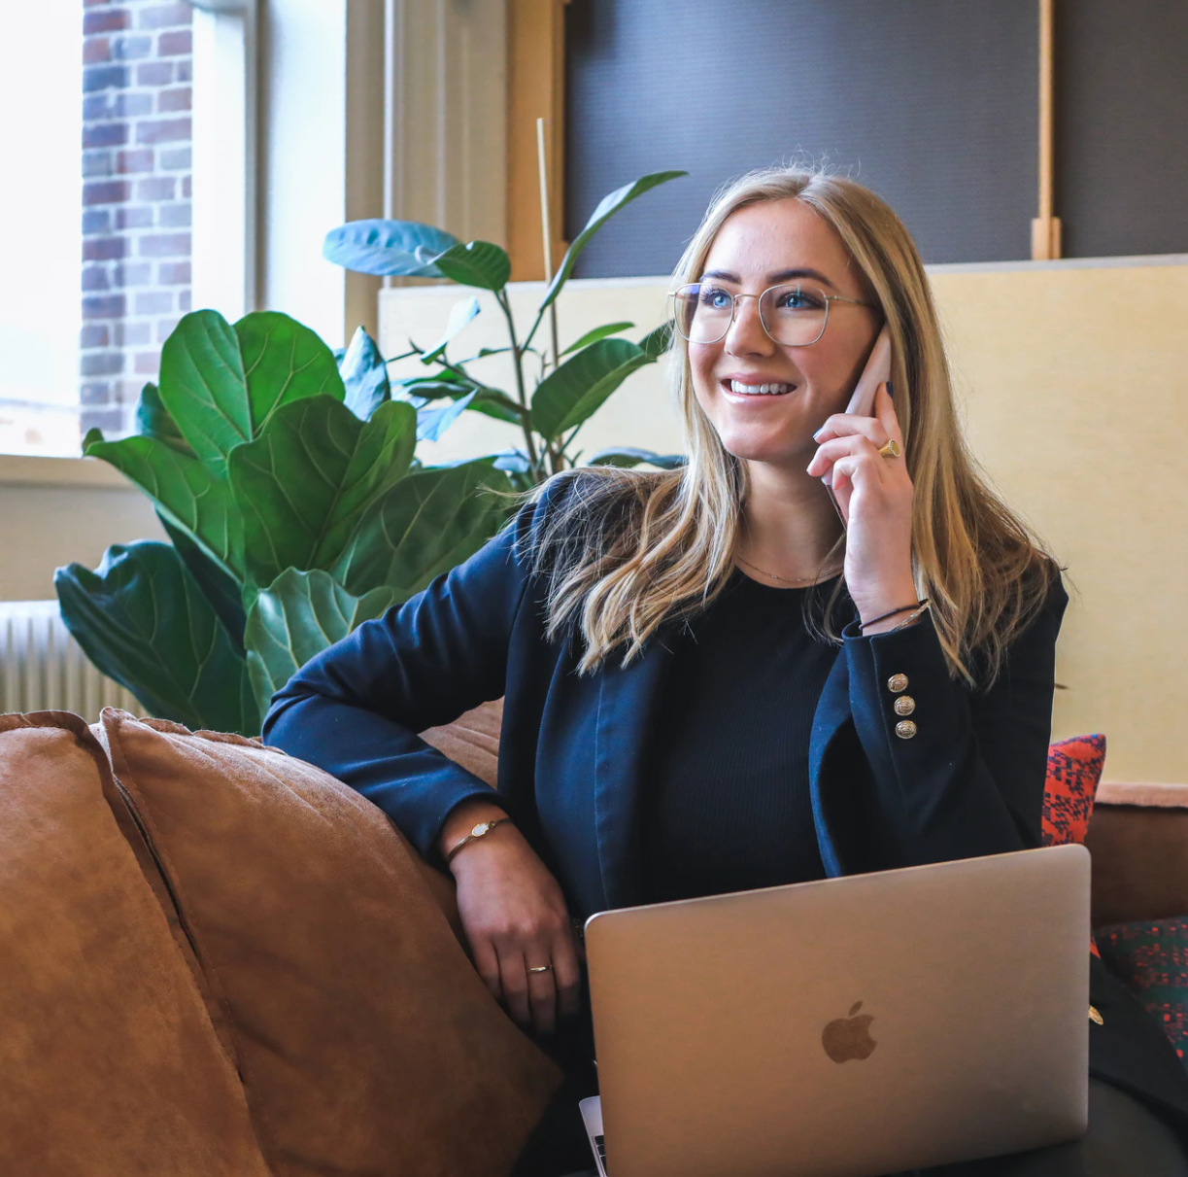
Who are you BEING while you are DOING?
Elements of Executive Presence
Emotional
Physical
  Poise* – composure
  Passion – emotion!
  Charisma – the “Rizz” – charm
  Energy – excitement
  Confidence – self-assured
Posture* – head up, shoulders back
Style* – current, conform, feel good
Face – eyes, eyebrows, mouth, headtilt
Voice – pitch, pace, volume, virus
Diction – enunciate and choose wisely
* Key to Powerful 1st Impression!

Slide 7
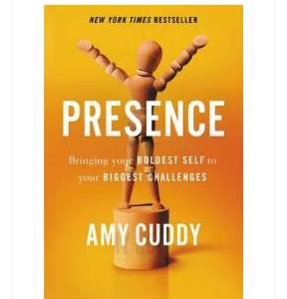

Confidence
How we perceive ourselves is key
Challenged? We MUST:
    Increase confidence AND energy
Let our bodies influence our brains
Two-minute PowerPose
  Reduces Cortisol
  Increases Testosterone
www.PressencePlus.us

Slide 8
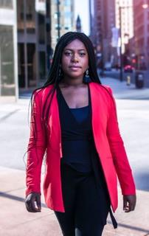
That Confidence Thing . . .
The Power of
Pause and Posture Check
AKA: “Don’t just stand there . . . Do nothing!”
Stressed before entering? Before speaking? While speaking?
Pause!
Breathe IN and OUT and IN again
Posture Check!
A 2-Second “Pause and Posture Check” will Boost Confidence!

Slide 9

Powerful Presence in Meetings
Choose Bold, Muscular Language
Avoid:
  How about . . .?
  I tend to agree . . .
  Well, what if . . .
  If you don’t mind, I would . . .
  Maybe . . .like . . . this idea . . .
  I’m not sure if . . .
  I think maybe we could . . .
  I just want to say . .
  Sorry if… Sorry for . . . Sorry I can’t make it . . .
Use:
  I strongly suggest . . .
  That is 100% correct, here’s why . . .
  I firmly believe we can . . .
  I unequivocally recommend that I do . . .
  We must comprehensively execute . . .
  I extensively researched and I advocate . . .
  I passionately endorse this strategy . . .
  I prescribe the following . . .
  Thank you for understanding . . .

Slide 10
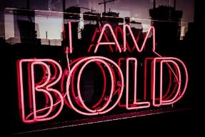
Choose Power Verbs to Enhance Diction
Embolden your Verbal and Written Communication
Leverage Impactful Action Verbs - instead of “X” use “Y”:
  Grow: Augment, Multiply, Amplify, Maximize, Elevate
  Achieve: Outperform, Exceed, Transcend, Surpass, Revitalize, Execute, Deliver, Surpass
  Communicate: Negotiate, Persuade, Network, Compose, Collaborate Inform, Guide, Disseminate, Illuminate
  Lead: Champion, Commanded, Initiate, Advocate, Orchestrate, Spearhead, Empower
  Organize: Transform, Integrate, Merge, Classify, Produce, Reposition, Develop, Execute, Connect
  Train: Illustrate, Instruct, Enlighten, Nurture, Direct, Expound, Form, Sharpen, Advise, Inform, Impart, Counsel
www.PresencePlus.us
MJ@PresencePlus.us

Slide 11
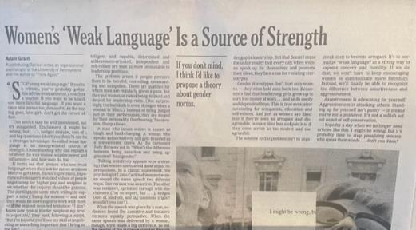
“Women’s ‘Weak Language’ is a Source of Strength”
X
-- Adam Grant
New York Times Opinion, Best Selling Author
July 31, 2023
MY challenge for Adam:
change one word to “Men’s” . . .

Slide 12


Personal Brand
What people say about you when you are NOT in the room
Components of Your Brand – 100% controllable
  Your Targets
  Your Actions
  Your Experience/Expertise/SUCCESSES
  Your Network – “Giving = Getting”
  Your Values
  Your Executive Presence
Bold, authentic self
Don’t be: “MJ The Girl Who Takes Notes!”

Slide 13

Personal Brand
Know Your Brand: What they say when . . .
Your Perception of You
Others’ Perception of You
Trait 1
Trait 2
Trait 3
Trait 4
Trait 5
Trait 6
Impression
Impression
Trait 1
Trait 2
TRAIT 3
Trait 4
Trait 5
Trait 6

Slide 14
Personal Brand
Two Sides to Every . . .
Impression
Trait 1
Trait 2
Trait 3
Trait 4
Trait 5
Trait6
Positive Traits
  Kind
  Positive
  Competent SME
  Thoughtful
  Provider of feedback
  Energized
  Enthusiastic
  Passionate
  Fun/Witty/Humorous
  Confident
Less Positive Traits
  Nice
  Naive
  Know it all/Note Taker
  Tentative/Unsure
  Condescending
  Hyper
  Pushy
  Don’t know when to stop
  Sarcastic/Mean
  Braggadocios

Slide 15
Know Your Personal Brand
Homework
Get your Personal Brand input from others!
Three adjectives or statements: strengths or opportunities:
  Analyze them as Positive or Less Positive
  Watch for: “You’re great BUT . . .” or “Wonderful UNTIL . . .”
  Think about how to actively address going forward
When? Get BEST input:
  After a meeting, after a project, after YOU offer it

Slide 16

Share Your Personal Brand
We are All Made of Stories!
Live your favorite stories!
Know your stories!
Share your stories!

Slide 17

Personal Brand Statement - Now … to WOW!
Unique Value Proposition to Impact
Product Brands connect people to THINGS – creative license
Personal Brands connect people to PEOPLE – genuine reflection
Catchy! Memorable and impactful
  What you do – Action!
  For whom you do it – Target!
  How you deliver value – Outcomes!
“I help people to feel comfortable and look confident in photos.”
-- Jordan Bellotti/Photographer

Slide 18


Personal Brand Statement/Pitch
30 Seconds – Don’t Speed!
I am an (Adjectives) ______________________ individual . . .
. . with a passion for (Actions with Targets) _____________________ _______________________________________________________.
I strive to accomplish (Outcomes for Targets) __________________ ___________________________________________________ . . .
. . . by doing (Actions) ____________________________________.
And. I love (FUN thing)!) __________________________________.

Slide 19
MJ’s Personal Brand Statement
I am an energized and empathetic former Fortune 50 Exec . . .
with a passion for empowering and developing professionals of all ages and career stages.
I share extensive formal training plus life lessons . . .
through one-on-one coaching sessions and keynote speaking events.
And . . . I love to perform with my electric guitar!

Slide 20
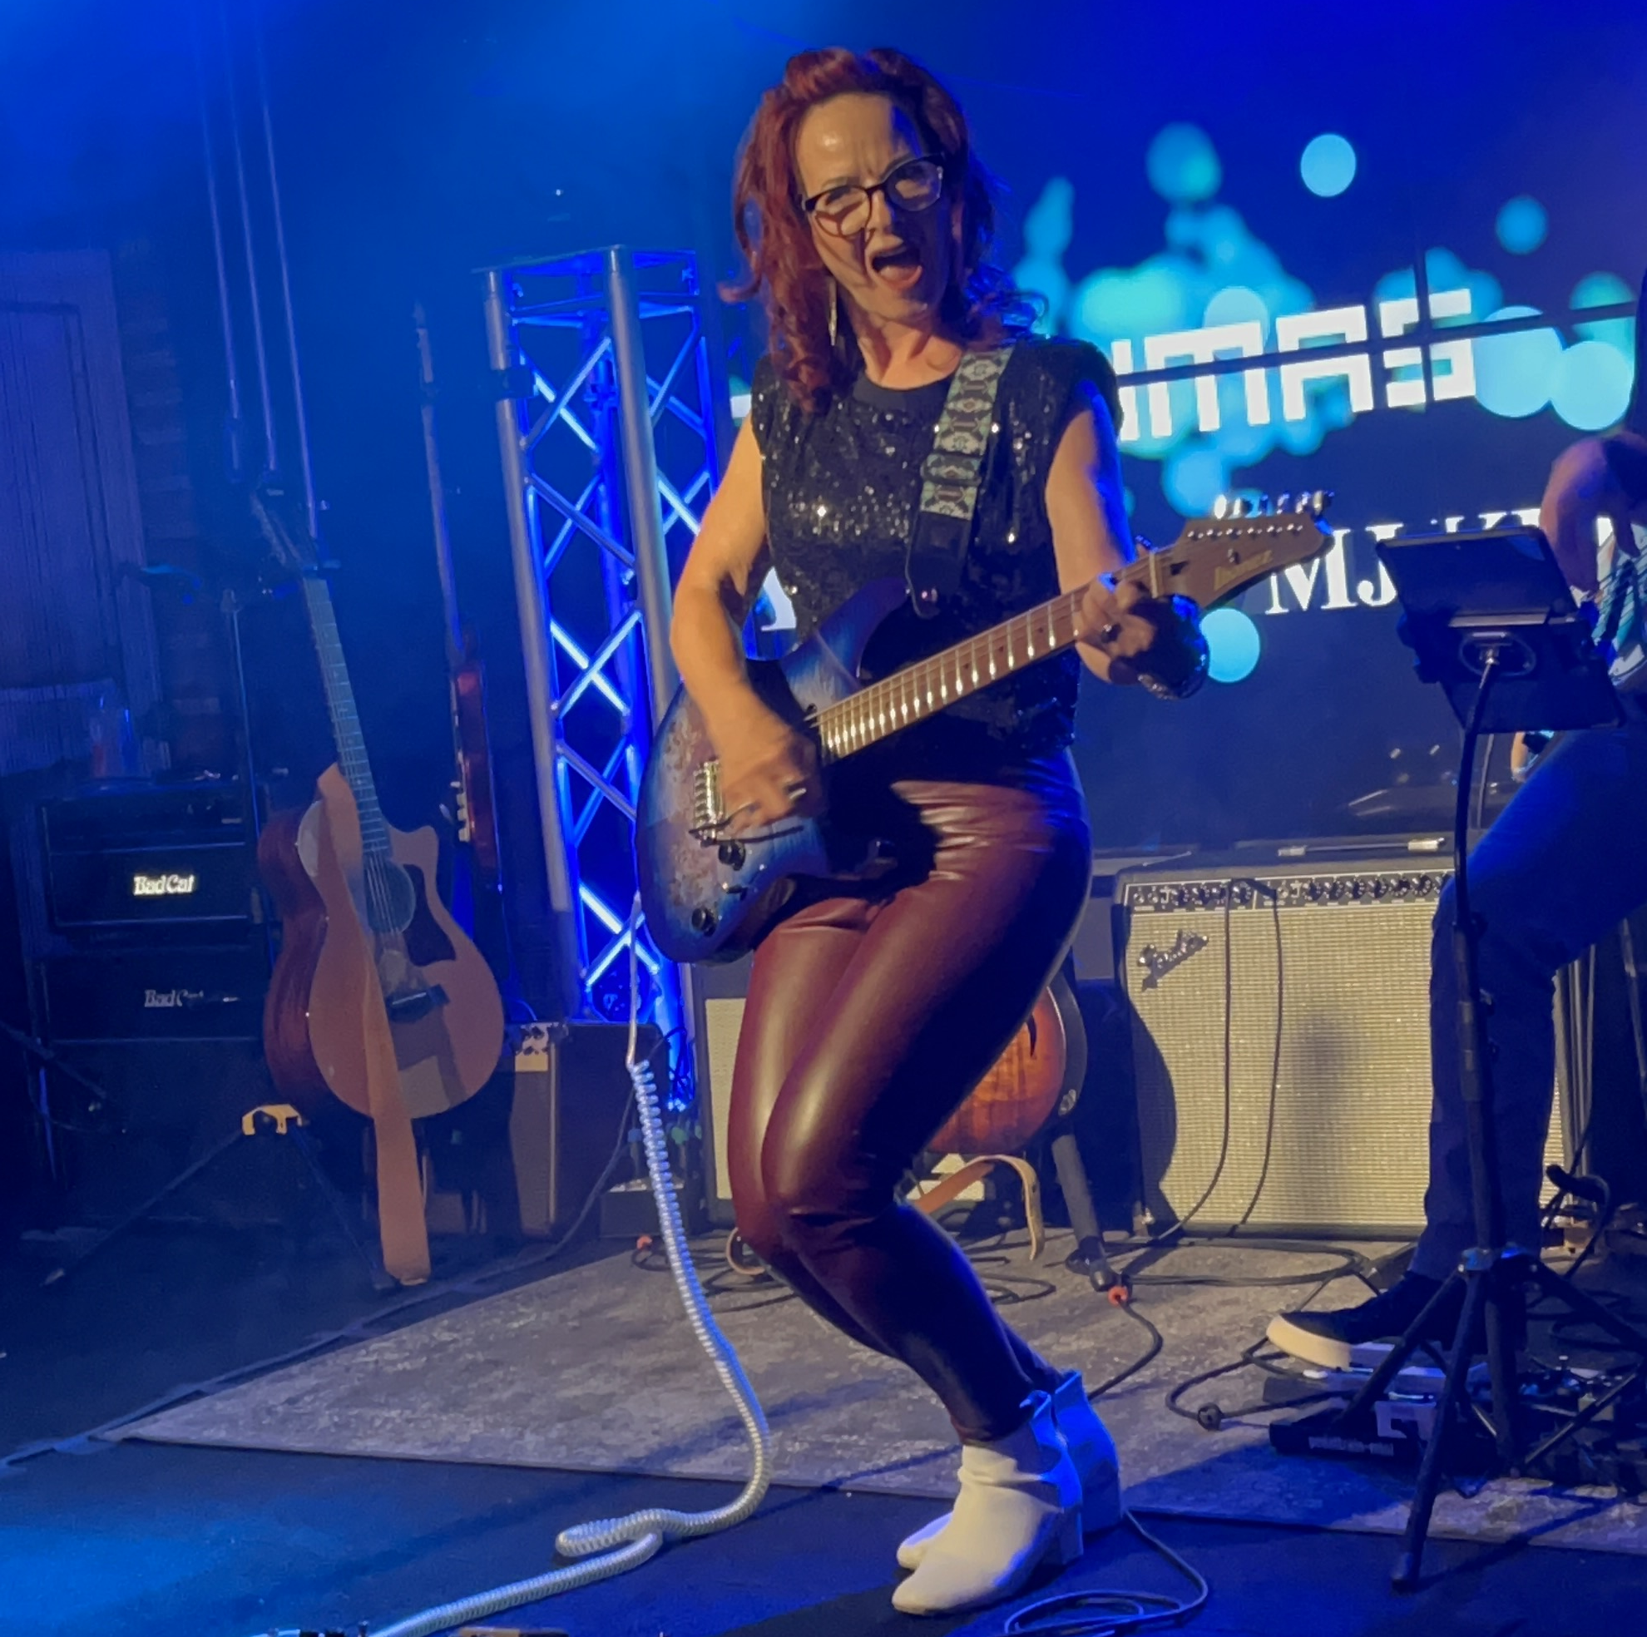
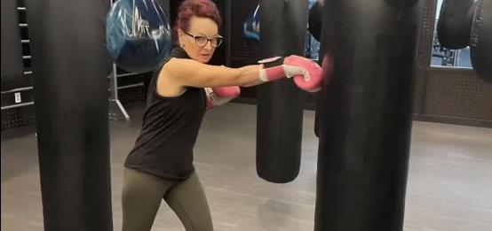
Punch that Pitch!
“I’m MJ Klimas, PresencePlus.
I empower women to develop their most bold and brilliant executive presence with
fun, flair . . . and a Fender guitar!”

Slide 21


  Punch your Personal Brand Statement
  Action! Target! Outcome!
X
“I’m (Name)___________, (Org.) ___________.”
“I (Action verb)____________ (Targets)___________
to (verb) _______________ (an Outcome) _______________.”
Fun!
“I help people to feel comfortable and look confident in photos.”
-- Jordan Bellotti/Photographer
“I empower ridiculously good marketing.”
-- Ann Handley

Slide 22
  Punchy Example
  Action! Target! Outcome!
X
“I’m Sam Smith, Board of NEWPF.
I orchestrate opportunities for women to connect
with financial services leaders and maximize their industry expertise.”
By the way. At 6 am, you’ll find me pumping iron!”

Slide 23
  WOW with a Personal Brand Question
  Action? Target? Outcome?
X
Pique curiosity with a question!
“I’m Sam(Name)___________, (Org.) ___________.”
“Because . . . do you . . . who doesn’t . . . why not . . .who can’t . . .”
Fun!
“(Because) do you want more online traffic?
-- Neil Patel, Online Marketer

Slide 24
  WOW with a Personal Brand Question
  Action? Target? Outcome?
X
Pique curiosity with a question!
“I’m Sam Smith, NEWPF.
Because why not be part of a bold and broad network of industry experts?
Outside the lab, I’m in Central Park with my Bichon.”
“(Because) do you want more online traffic?
-- Neil Patel, Online Marketer

Slide 25

Action! Target! Outcome!
I (action verb)…(targets)… to (verb) . . . (an outcome) . . .”
Action
  Enlighten
  Transform
  Motivate
  Elevate
  Maximize
  Deliver
  Develop
  Market
  Orchestrate
  Create
  Empower
Target
People
Students
Faculty
Research
Teams
Projects
Products
Problems
Data
Clients Expenses
Outcome
Success
Excellence
Engagement
Commitment
Graduates
Brilliance
Dynamic Results
Value
Hope
Solutions
“I translate ‘Geek Speak’ . . . to make it more understandable for you.”
-- Brian Fanzo/iSocialFanz

Slide 26

“I’m MJ. An Executive Presence Consultant.
Because who doesn’t want to be
Bold and Brilliant?!?”
-- MJ Klimas, Principal, PresencePlus

Slide 27
Power, Presence, and Personal Brand
Be Aware. Be Thoughtful. Choose.
  Power
  Powerful First Impressions
  Executive Presence
    What people THINK when you are “in the room” or “on the Zoom”
      Emotional and Physical Components including Bold, Muscular Language
  Personal Brand
    What people SAY when you are NOT “in the room” or “on the Zoom”
    Know your brand! Pitch your brand! Punch your brand!

Slide 28
References & Contact
“Presence” – Amy Cuddy, Copyright 2015
“Presentation Skills” – Paul LeRoux, Copyright 1984
“Women Find Your Voice” – Harvard Business Review, June 2014
“4 Vocal Viruses that Could Stifle Your Career” – Center for Advanced Legal Studies 2013
“Unsplash” – legal, stock photos
Contact:
  MJ Klimas
  MJ@PresencePlus.us
  724-504-7520
  Website: www.PresencePlus.us

