Slide 1

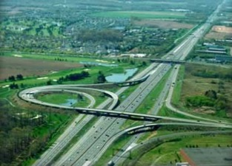
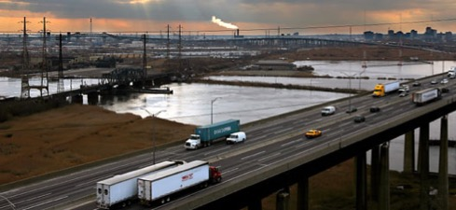
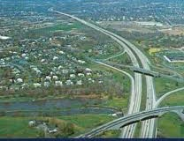

New Jersey Turnpike Authority
Northeast Women in Public Finance Transportation Panel
February 2, 2017

Slide 2
Highlights
Well established, essential roads serving as an important commuter route and a critical link along the I-95/Northeast Corridor Turnpike opened in 1951, Parkway in 1954 Serves a densely populated and wealthy region Acts as a “supply chain spine” and “distribution platform” for the entire northeast Turnpike covers 148 miles, with 28 interchanges and 366 toll lanes Parkway covers 173 miles, 359 exits and entrances and 236 toll lanes The Turnpike System is in a state of good repair Conservative approach to financial and operational management of the Authority has resulted in strong performances for the past several years In 2015, collected the highest amount of toll revenue in the country, yet maintains some of the lowest mainline through trip toll rates per mile in the nation (Turnpike $0.114 and Parkway $0.048) Demonstrated history of toll increase discipline Raised tolls four times over the past 15 years Reduced/eliminated E-ZPass discounts three times over the past 15 years
The E-Z Pass penetration rates have increased to over 82% on the Turnpike and nearly 80% on the Parkway E-Z Pass penetration among the highest in the country Has a significantly lower toll collection cost per transaction than manual toll collection

Slide 3
Fast Facts
      2016 Toll Revenue
        New Jersey Turnpike - $1.2 billion
        Garden State Parkway - .4 billion
      $1.6 billion
        Record level of toll revenue
      On average, $4.3 million/day in toll revenue collected
      2016 Total Revenue - $1.8 billion
      2016 Total Vehicles on the New Jersey Turnpike – 255.5 million
        Record level of traffic
      2016 Total Commercial Vehicles on the New Jersey Turnpike - 31.9 million
        Highest level since 2008, record level in 2007 33.2 million

Slide 4
Fast Facts (Continued)
      2016 Total Passenger Vehicles on the New Jersey Turnpike – 384.6 million
        Record level of passenger car traffic
      Total Lane miles
        New Jersey Turnpike - 1,819
        Garden State Parkway - 1,778
        3,597
      Total Outstanding Debt - $11.0 billion
        Average life < 21 years
      Total Capital Assets – Net - $11.3 billion
        70% of net capital assets have average lives > 65 years

Slide 5
Authority Goals
      Complete the current $7 billion capital program within budget
      Complete debt funding of the current $7 billion capital program at an all in cost under 5%
      Develop and adopt the next Strategic Plan
        Essentially the first ever Strategic plan
        The preliminary identified goals are
          1. Improve safety for patrons and employees
          2. Improve financial strength
          3. Decrease congestion/Improve mobility for patrons
          4. Maintain a state of good repair for all assets
          5. Maintain and attract a quality workforce
        The strategic plan will guide the development of the next capital program
      Complete consolidation of administrative offices into one facility at 1 Turnpike Plaza, including the establishment of a back-up data center for the entire Authority operations and a back-up data center for the Statewide Traffic Management Center managed by the Authority
        First time since consolidation in 2003 that all administration functions are housed in one location

Slide 6
Authority Goals (Continued)
      Transition to the new contract with Xerox for New Jersey E-ZPass operations, which will include customer service enhancements and potential future cost savings for the Authority
        Mobile app will be offered
        All E-Z Pass and violator accounts will be consolidated into one account
        Enhanced collection and enforcement efforts
      Establish an OPEB Trust and cash fund at least 50% of the annual required contribution
        Annual required contribution is approximately $100 million
      Increase the minimum General Reserve Fund balance contained in the board adopted policy. Maintain or improve credit ratings.
        On 1/31/17, the Board approved an amendment to the policy to increase the minimum General Reserve Fund balance to equal 10% of total revenue to be phased in over 3 years

Slide 7
Authority Goals
      Begin replacement/upgrade of toll collection system including requirements for National Toll Interoperability
        Existing toll collection system is over 17 years old and is near the end of its useful life
        Selection of “national protocol could result in the need for dual readers in the lane if E-Z Pass is not selected
        Involves the replacement of a total of 602 lanes on both roadways
      Implement new re-designed website
        Enhancements to real-time traffic and roadway views
        On-line job applications
        Easier navigation
      Continue to enhance transparency and disclosure
        Continue practice of monthly reporting of traffic and revenue numbers
        Recent GFOA awards for Annual Budget and CAFR
        Quarterly financial analysis and reporting

Slide 8
Future Debt Issuance
      The following debt issuances are planned for early 2017:
      New money issue of approximately $525 million to continue to fund the $7 billion capital program
      Fixed rate advance refunding for savings of all or a portion of the $300 million of Series 2009E bonds, $306 million of Series 2009H bonds, and $178 million of Series 2009I bonds. The refunding would be completed if minimum net present value savings of 3% and refunding efficiency savings of 70% are met.
      The following debt issuances are planned for late 2017:
      Refund the Series 2013D-3, Series 2013E-3 and Series 2014B-3 floating rate notes at a total par value of $179 million. These bonds have a mandatory tender date of 1/1/18 and a refunding prior to that date will avoid interest rate escalations.
      The following debt issuances may occur in 2017:
      Fixed or variable rate refunding of the $400 million Series 2000B-G auction rate bonds for savings. The auctions have failed since 2009, with a fail rate equal to 175% of 30 day LIBOR. The Authority receives 5 year LIBOR on the interest rate SWAPs associated with these bonds, and as the yield curve flattens the cost to the Authority increases
      Debt issuances beyond 2017:
      New money issue of approximately $500 million in early 2018 to continue to fund the $7 billion capital program
      New money issue of approximately $300 million in early 2019 to continue to fund the $7 billion capital program

Slide 9
Status of Agreements with State of New Jersey
      State Transportation Projects Funding Agreement
      The State Transportation Projects Funding Agreement, approved by the Authority in 2011, expired on June 30, 2016. Under this five year agreement, the Authority made total payments of $1.527 billion to the State of New Jersey for state transportation purposes.
      A successor State Transportation Projects Funding Agreement was approved by the Authority’s Board of Commissioners in June 2016. Under this new five year agreement, the Authority will make total payments of $797 million.
      Feeder Road Maintenance and Cost Sharing Agreement
      The most recent annual Feeder Road Maintenance Agreement required payments of $8 million to the state DOT to reimburse the state for the reconstruction, maintenance and repair of feeder roads. The last annual agreement expired on June 30, 2016.
      A successor 7 year Feeder Road Maintenance Agreement was approved by the Authority’s Board of Commissioners in June 2016. Under this new agreement, the Authority will make payments to the state that will gradually reduce to $2.5 million per year. Total payments under this agreement will be $29.75 million, as compared to $56 million had payments remained at the annual $8 million level throughout the agreement.
      North Avenue Corridor Project
      In August 2009, the Authority’s Board of Commissioners approved a $45 million participation in the North Avenue Corridor Project with the Port Authority of New York and New Jersey and the state DOT. The $45 million was payable over 10 years, and was budgeted annually by the Authority. No payments were made as an agreement was never signed and the project was removed from the state DOT’s capital plan.
      In June 2016, the Authority’s Board of Commissioners rescinded the August 2009 approval, thus eliminating the need for the Authority to continue to budget for the $4.5 million annual payment over 10 years.

Slide 10
The Authority Has Committed 92% of its $7 Billion CIP
In the eighth year of the program, the Authority has spent or committed 92%, or $6.420 billion, of its original $7 billion budget with minimal impact to traffic
Program includes 37 projects across the Turnpike and Parkway and is currently under budget and on schedule
Savings realized due to competitive construction market has enabled additional projects to be added to the program while remaining within the $7 billion budget
Due to these realized construction costs savings, the second and third phases of the Parkway widening program and the Great Egg Harbor and Drag Channel Bridges were added to the CIP
Once the Parkway widening from MP 35-80 and other improvements from MP 83-100 are completed, one-third of the Parkway will have been reconstructed and 4 of the 6 major bridges will have been replaced or refurbished
Program | Original Budget | Current Budget | Project Amount Spent or Committed to Date | Percent Spent or Committed to Date | Under Budget or Increased Scope
Turnpike Widening (Interchange 6-9) | $2,500,000,000 | $2,231,399,000 | $2,132,257,000 | 96% | ✓
Bridge Improvements | 1,775,000,000 | 1,682,762,000 | 1,387,921,000 | 82% | ✓
Interchange Improvements | 960,000,000 | 1,026,431,000 | 936,032,000 | 91% | ✓
Roadway Improvements | 990,000,000 | 816,783,000 | 793,746,000 | 97% | ✓
Facilities Improvements | 575,000,000 | 652,625,000 | 614,940,000 | 94% | ✓
Parkway Widening (Milepost 35-80)* | 200,000,000 | 590,000,000* | 555,097,000 | 94% | ✓
Total | $7,000,000,000 | $7,000,000,000 | $6,419,993,000 | 92%
*Parkway 35-80 Widening Program’s Budget is $690mm, but $100mm was financed with BAN proceeds issued prior to the first series of bonds issued for the CIP

Slide 11
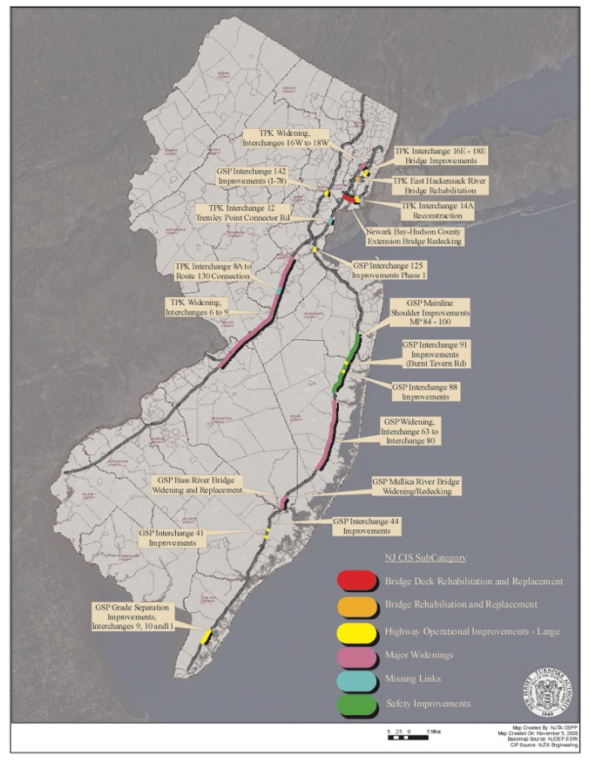
Map of Major Turnpike and Parkway Projects

Slide 12
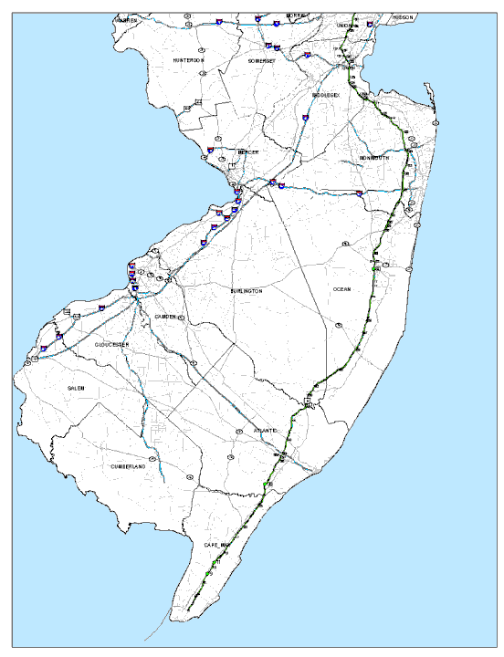
Widening Projects
Turnpike Interchange 6 to 9 Widening
Parkway Interchange 63 to 80 (Phase 1)
Parkway Interchange 48 to 63 (Phase 2)
Parkway Interchange 35 to 48 (Phase 3)
Interchange 9
Interchange 80
Toms River
Ocean County
Interchange 6
Phase 1
Phase 2
Phase 3

Slide 13
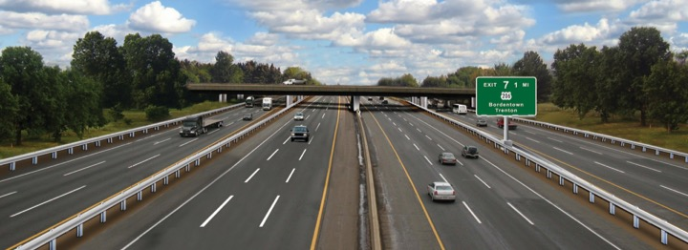
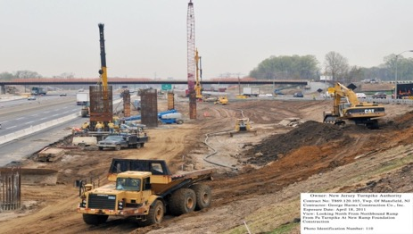
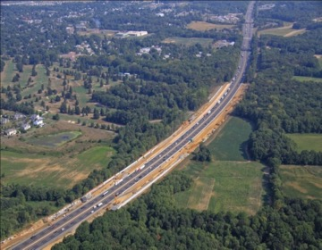
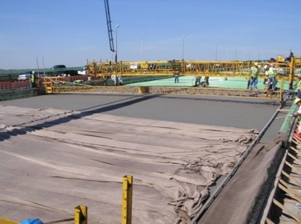
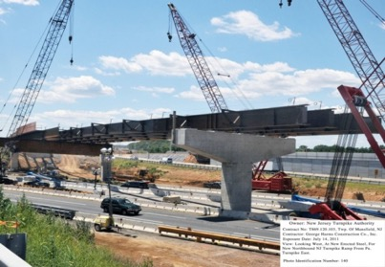
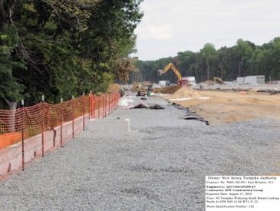
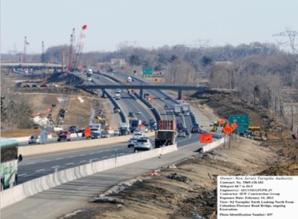
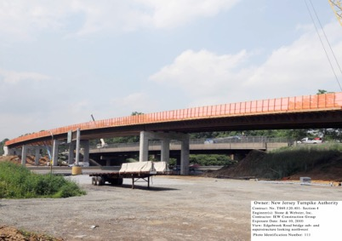
Turnpike Interchange 6 to 9 Widening Program

Slide 14
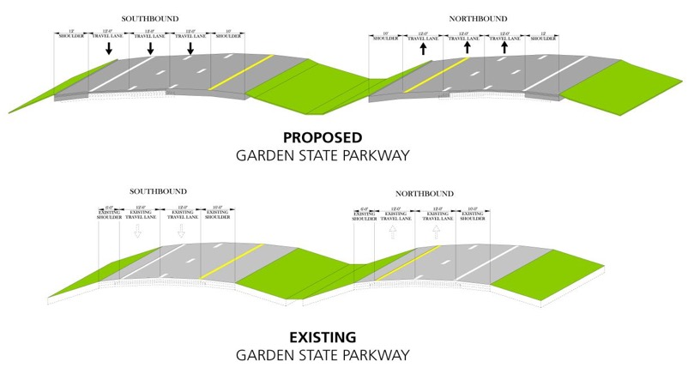
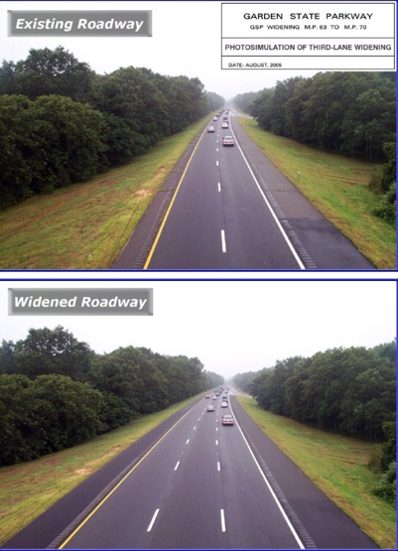
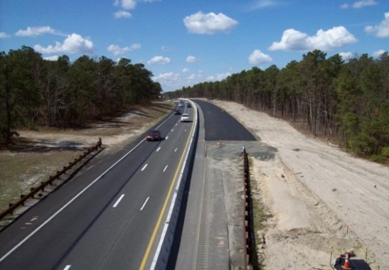
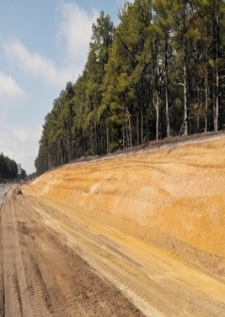
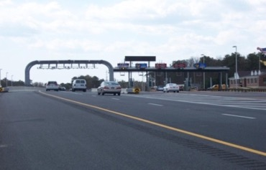
Widening of the GSP Int. 35 to 80

Slide 15
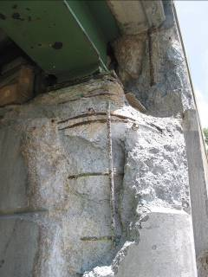
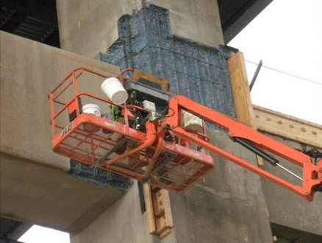
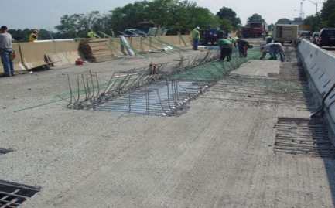
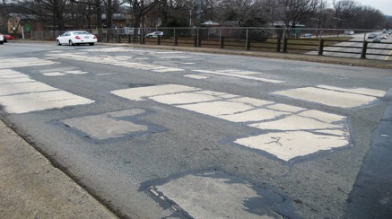
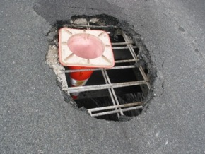
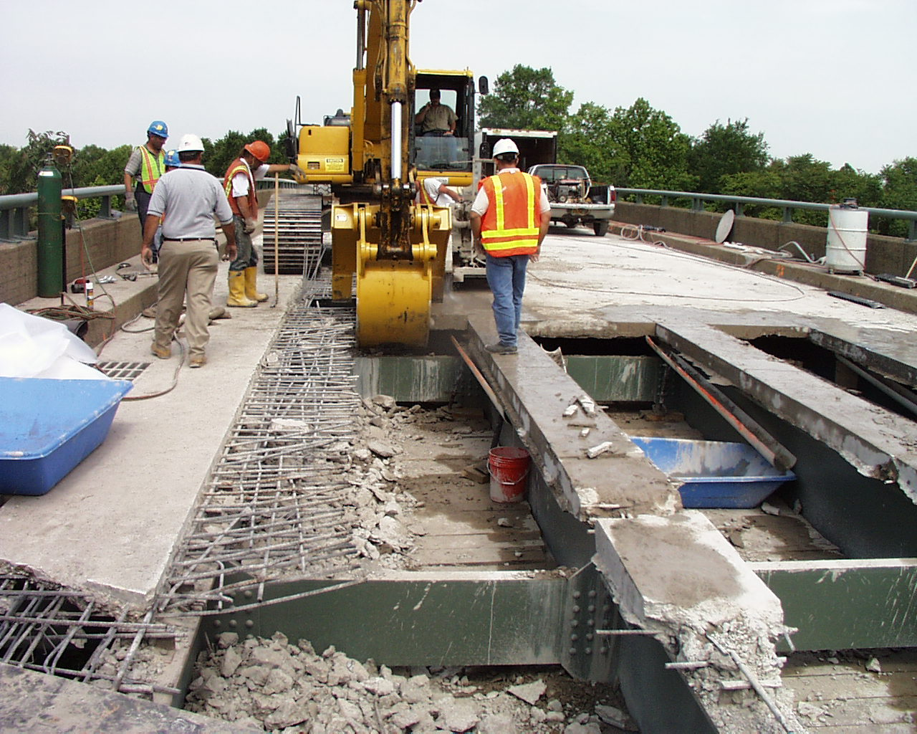
Bridge Improvements
Bridge Deck Reconstruction
Bridge Security
Substructure Repairs
Bridge Painting
New Bridge Construction

Slide 16
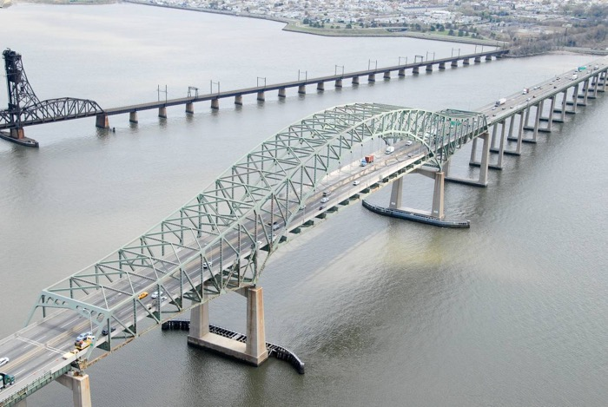
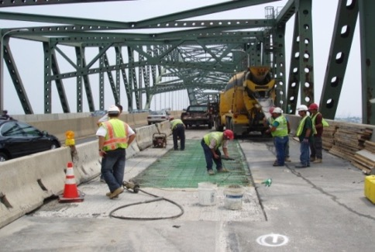
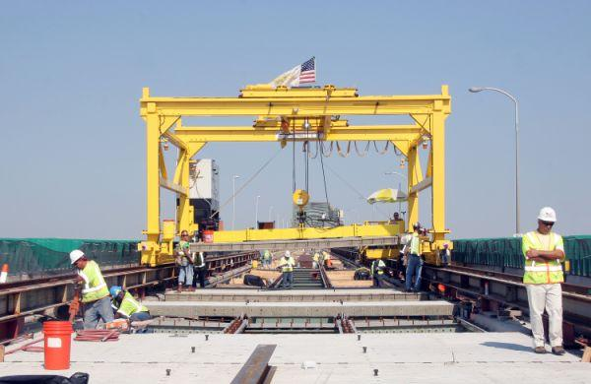
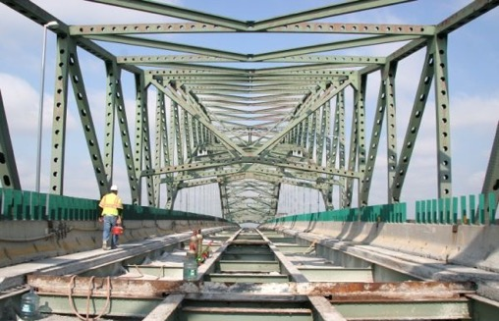
Bridge Improvements - TPK Newark Bay Bridge Deck Replacement

Slide 17
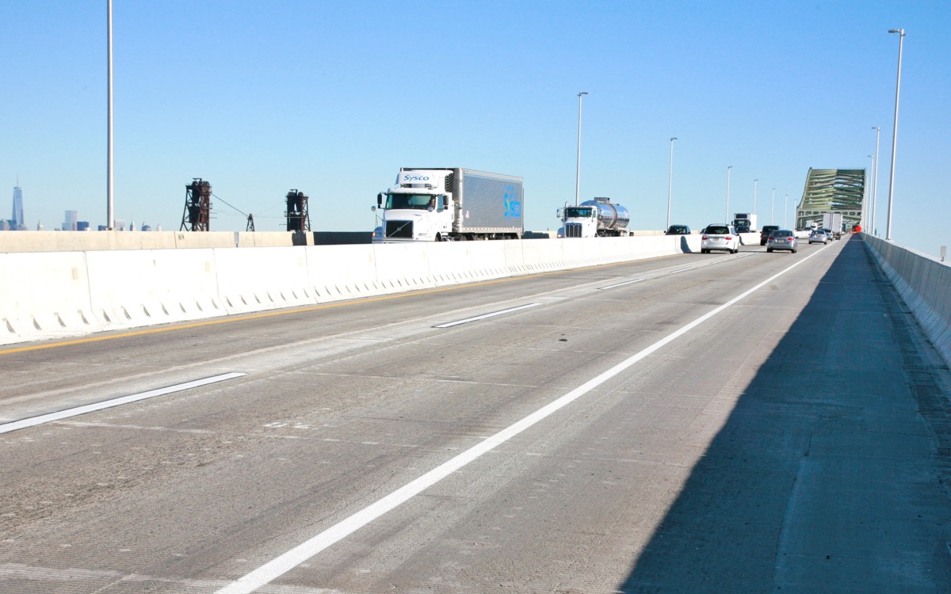
Bridge Improvements - TPK Newark Bay Bridge Deck Replacement

Slide 18
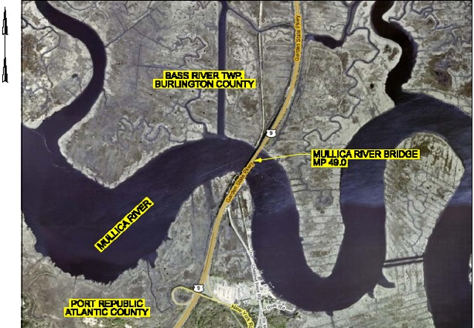
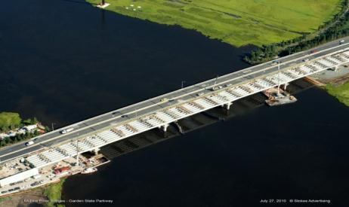
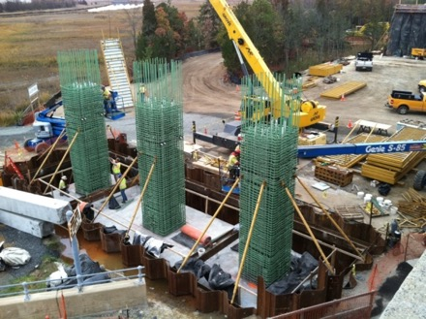
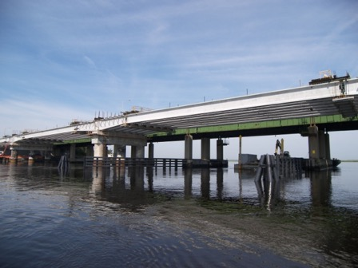
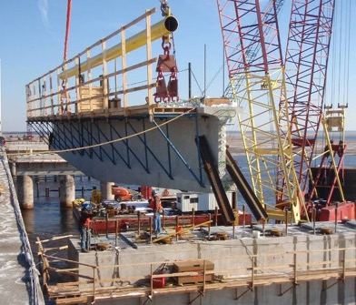
Bridge Improvements - Mullica River Bridge

Slide 19
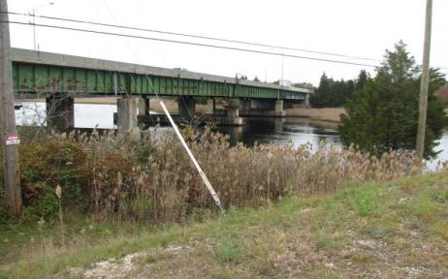
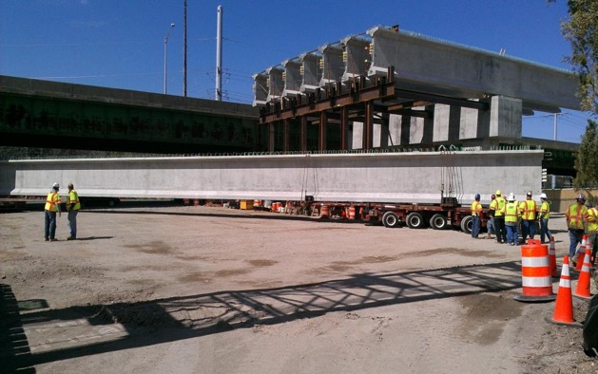
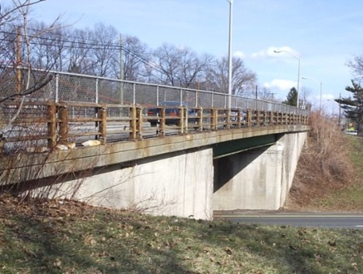
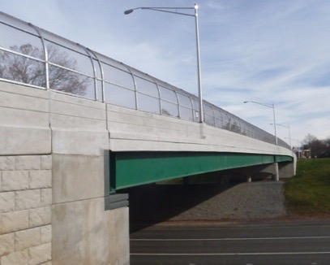
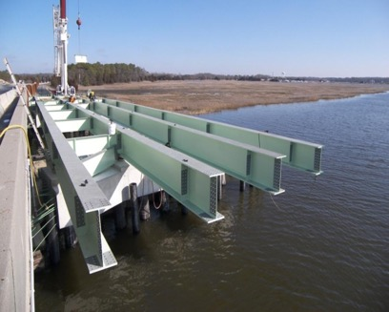
Bridge Improvements –
Bass River, Patcong Creek, Watchung Ave. Bridge Replacement

Slide 20
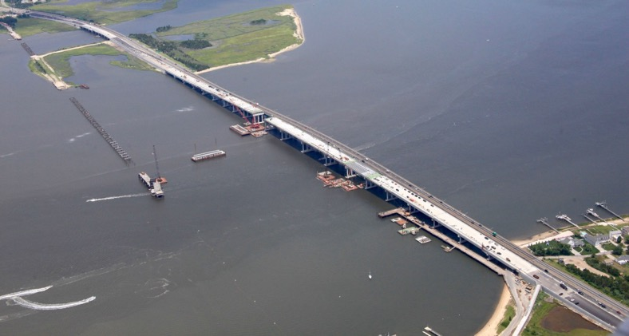
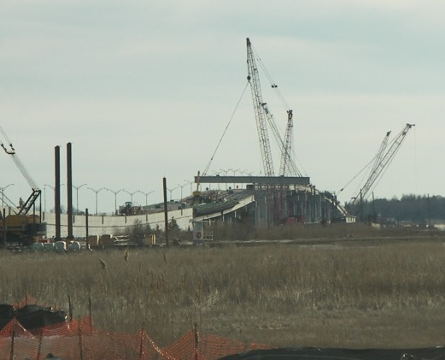
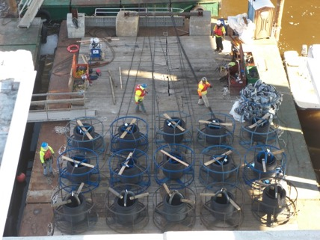
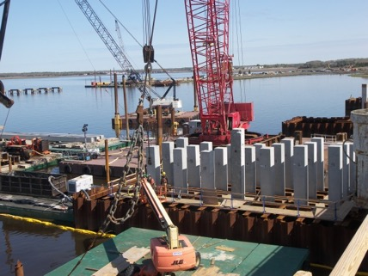
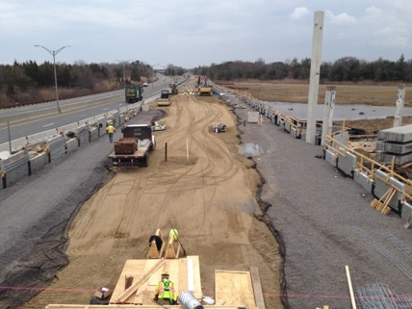
Bridge Improvements - Great Egg Harbor SB Bridge Replacement

Slide 21
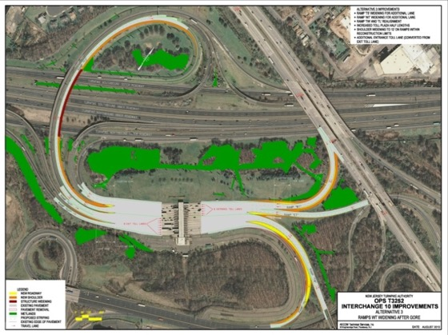
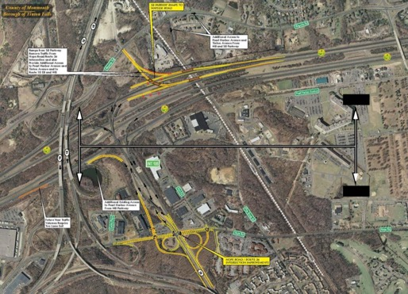
Interchange Improvements
TURNPIKE | PARKWAY
Interchange 9 | Interchange 0
Interchange 10 | Interchange 9, 10, and 11
Interchange 14A | Interchange 41 & 44
Interchange 15W | Interchange 88 / 89
Interchange 16W | Interchange 105
 | Interchange 125
 | Interchange 163
Turnpike Interchange 10
Parkway Interchange 105

Slide 22
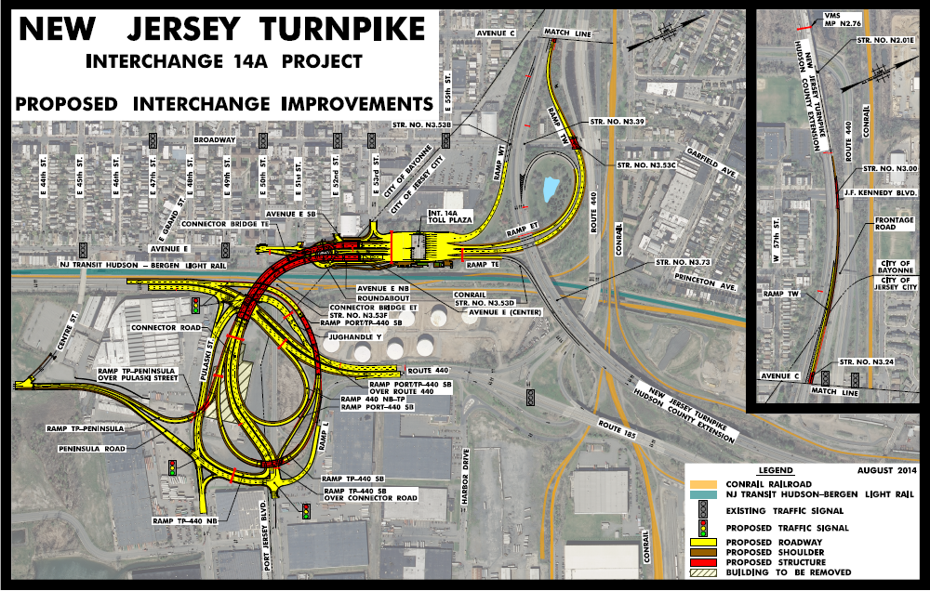
Interchange Improvements - TPK Interchange 14A Improvements Project

Slide 23
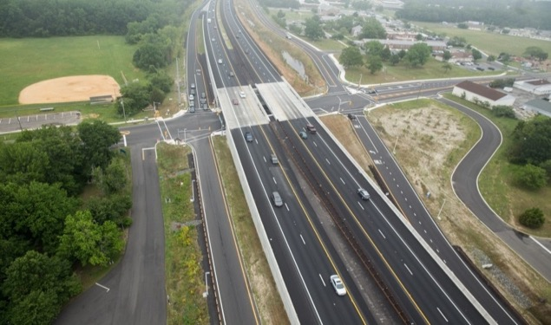
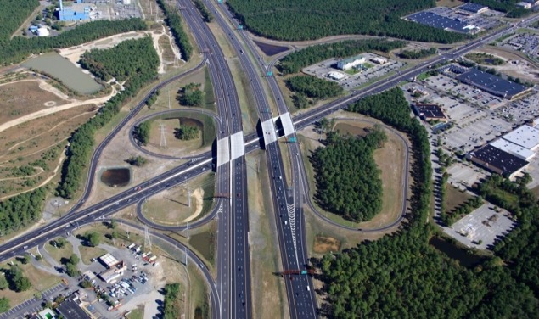
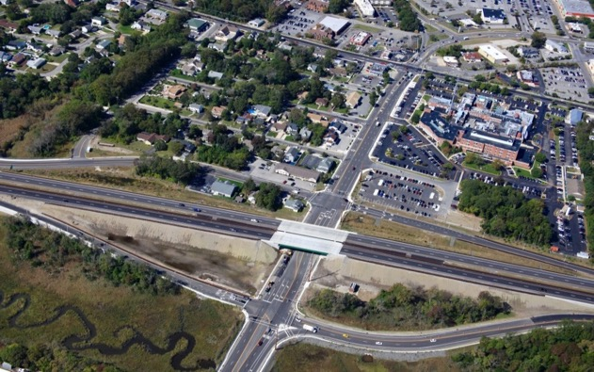

Interchange Improvements - GSP Interchange 9, 10 and 11

Slide 24

Interchange Improvements - GSP Interchange 125

Slide 25






Roadway Improvements
Pavement Resurfacing / Rehabilitation
Median Barrier Reconstruction
Roadway Signing – Static and VMS
Drainage Repairs
GSP Shoulder Reconstruction - MP 83 to 100

Slide 26




Roadway Improvements
Median Barrier Improvements
Sign Replacement Program

Slide 27



Roadway Improvements - Sign Replacement Program

Slide 28




Roadway Improvements - Variable Message Signs – 240 Signs

Slide 29





GSP Shoulder Reconstruction – MP 83 to 100
Parkway Interchange 88 / 89

Slide 30

Facility Improvements

Slide 31




Facility Improvements
4 State Police Facilities
Central Services
13 Salt Facilities
15 Maintenance Districts Multi-use Buildings

Slide 32



Facility Improvements - Multi-Use Building

Slide 33
Future Capital Improvement Opportunities
  State of Good Repair – Northern End of State
    Pavement Resurfacing / Rehabilitation
    Deck Replacement / Reconstruction
  Operational and Safety Improvements
    Interchange Geometry and Completion
    Toll Collection Opportunities
  Capacity Improvements
    Corridor Analysis
    Interchange Improvements
  Others

